Slide 1
fun main() {
println(“Hello Everyone!!”)
}

Slide 2
President University
Shuttle Bus App
Lambe Turah Company
Copyright © 2019 Designed by Hafizh Hakim

Slide 3
Lambe Turah Company
Director : Egi
Designer : Hafiz
Idea team : Dimas and Anggi
Name Thinker : Bahar

Slide 4
Agenda :
Problem
Opportunity
Insight
Solution
All in One

Slide 5
Problem

Slide 6
Problem
A lot of Pollution
Many student are lazy to use public transportation
Too few buses
Incorrect arrival and departure schedules
Not knowing the whereabouts of the bus
There is easier but expensive transportation

Slide 7
Opportunity

Slide 8
Opportunity
Make it easy for students to see bus departures and arrivals.
Make it easy for students to track the whereabouts of the bus.
Make it easy for students to find out which benches have been filled.
Make it easy for students to book a seat.

Slide 9
Insight

Slide 10
Insight
Too few buses
Incorrect arrival and departure schedules
Not knowing the whereabouts of the bus
There is easier but expensive transportation
Notes:
Our idea is PU Shuttle Bus Application, based on the problem it is very difficult to know the bus schedule. When we want to go to campus by bus, we don't know where it is now and if we want to go to the hostel by bus, we also don't know exactly where the bus is. If we know the bus schedule and position, we can get ready first, no need to wait long and don't have to worry about missing the bus. Next is the availability of seats. If we see a bus, we have to know how many seats are available. Because we don't have many buses and the buses we have are not big enough to carry all the people who want to go to campus. Sometimes the bus is very crowded, it makes the situation uncomfortable. Sometimes the bus is late, which makes students use other ways to go to campus such as using online transportation or using their motorcycle, it will create additional costs. Another problem is when the bus is late, we cannot be sure what caused the bus to be late. When the bus is late they will use other transportation as I said before. When they use their own motorbikes, which can create more pollution, and that will make the vehicles on the road more piling up which can create more pollution again and again. Therefore we want to make it easier to find out seat schedules and slots using the application on a mobile phone, which can make it easier for all President University students to do activities using buses.

Slide 11
All in one app

Slide 12
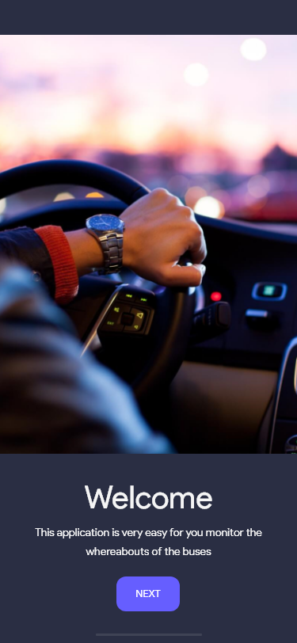
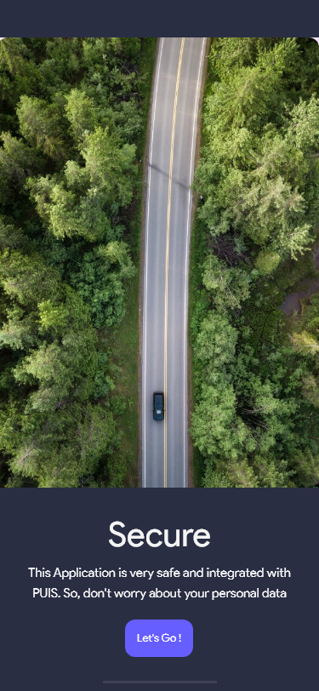
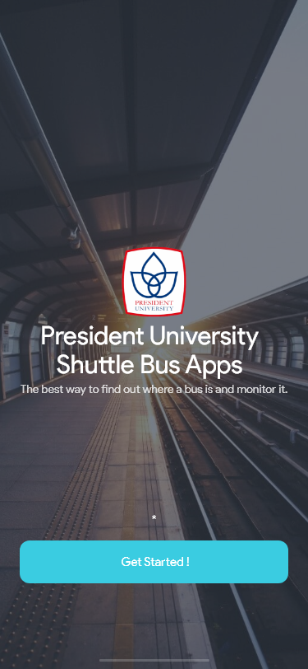
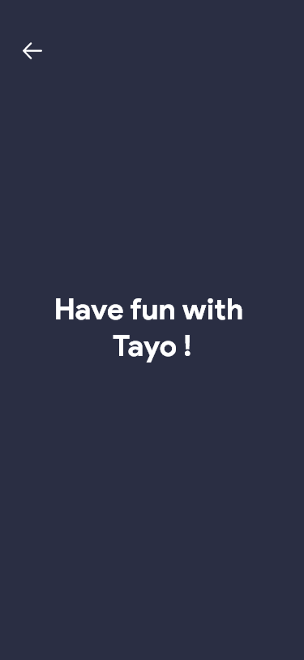
User Friendly

Slide 13
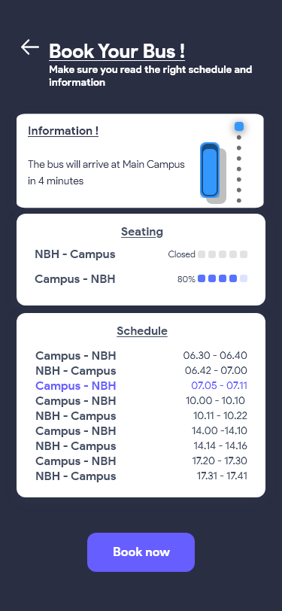
The Information
This feature will inform you about whereabouts of your bus. So, don’t worry if you are afraid of being late because you don’t know the information about bus

Slide 14
Passenger capasity
You don’t need to worry about passenger capacity issues. Because we will display what percentage of passenger capacity.

Slide 15
The Schedule
Now you can see bus arrivals and departures. So, don’t worry about confusion looking for a schedule

Slide 16
Secure App
This application is very safe and guarantees all confidentiality of your personal data.

Slide 17
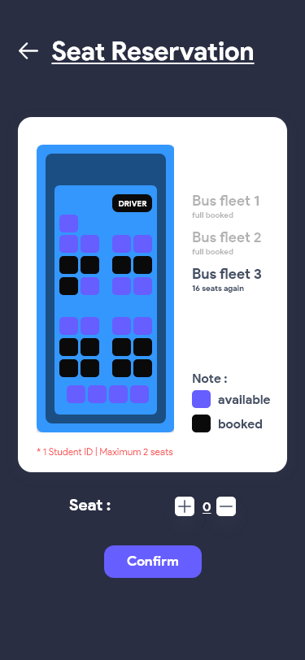
Seat Reservation
Say no to the fullness of the seat !!
Now, you can book a seat, and you can find out witch seats are empty and not empty.

Slide 18
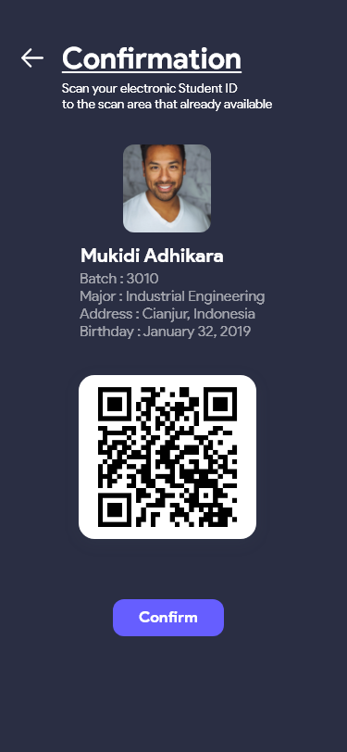
Confirmation Ticket
We use PUIS for passenger confirmation. So, there are no more stowaways as long as they get on the bus.

Slide 19
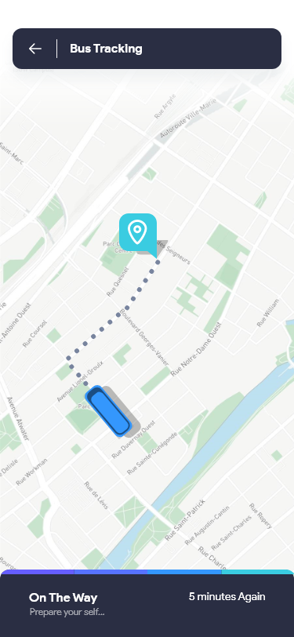
Bus Tracking
Are you afraid to miss the bus ?
Now don’t worry, because we provide the bus tracking feature. So, you can find out the whereabouts of the bus.

Slide 20
Any Question ?

Slide 21
Thanks

